Slide 1

Field of Medicine
Medicine Program
Lecture : (Autonomic Nervous System 2 )
Dr : (Mohamed Talal)
Date: / 10 / 2026

Slide 2
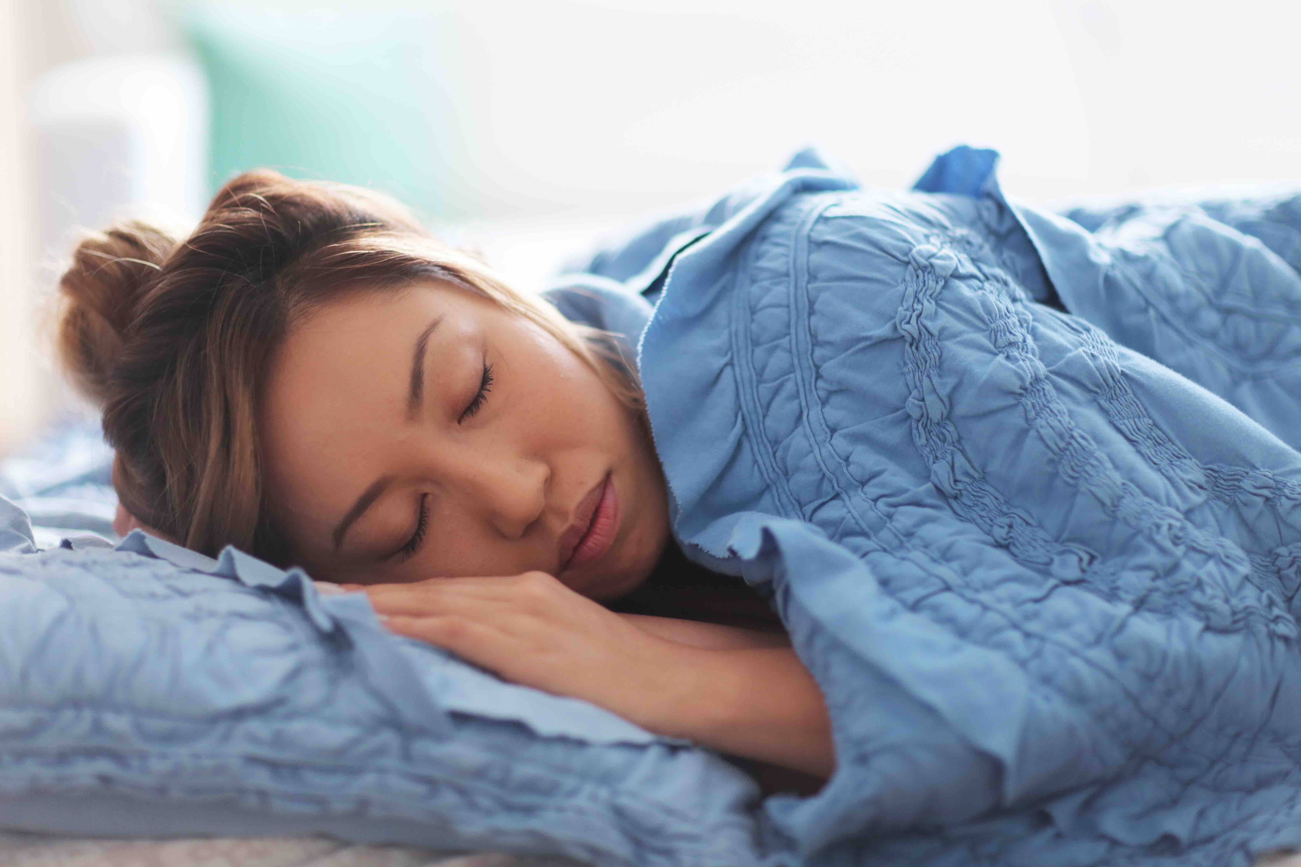
Divisions of Autonomic nervous system
Parasympathetic nervous system :

Slide 3
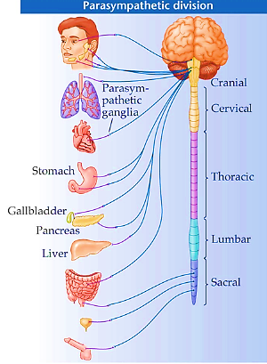
parasympathetic nervous system
Origin :
  cranio-sacral
Cranial outflow | Sacral outflow
Oculomotor nerve (head and neck) Facial nerve (head and neck) Glossopharyngeal nerve (head and neck) Vagus nerve ( thorax – abdomen ) | pelvic branches of S2-S3 and S4 (pelvis )

Slide 4
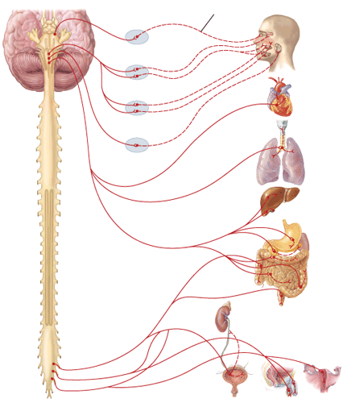
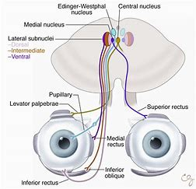
Parasympathetic nervous system
Effect on head and neck :
Oculomotor nerve (3rd cranial nerve):
origin : Edinger – Westphal nucleus of midbrain
relay : ciliary ganglion
Action :
  eye : pupil constriction ( contraction of constrictor pupillae muscle )

Slide 5
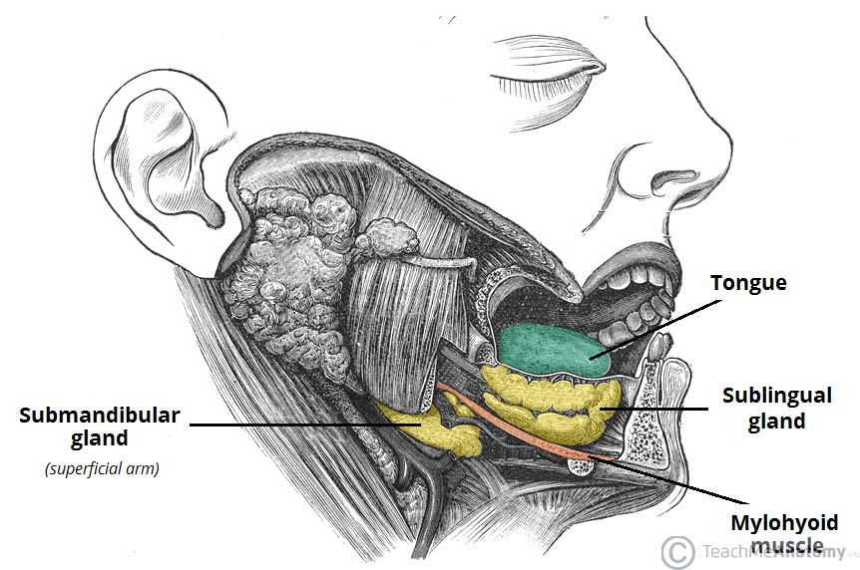
Parasympathetic nervous system
Effect on head and neck :
Facial nerve: (7th cranial nerve)
origin : superior salivary nucleus in pons
relay : sphenopalatine ganglion
Action : On sublingual and submandibular glands :
  Increases their secretions

Slide 6
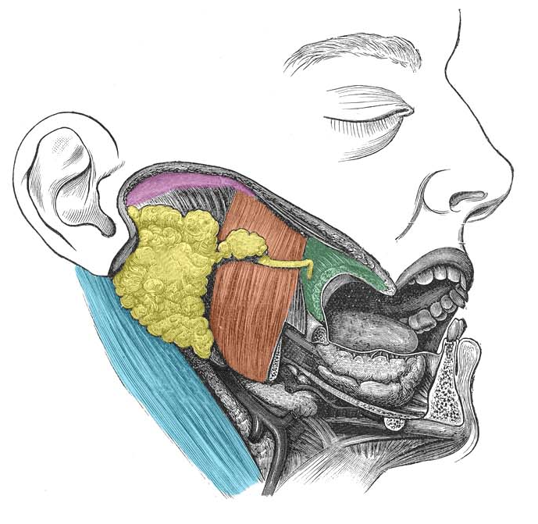
Parasympathetic nervous system
Effect on head and neck :
Glossopharyngeal nerve : ( 9th cranial nerve )
origin : inferior salivary nucleus in medulla
relay : otic ganglia
Action : On parotid gland :
  Increases its secretions

Slide 7

Parasympathetic nervous system
Effect on thorax and abdomen :
vagus nerve : ( 10th cranial nerve )
origin : vagal nucleus in medulla
relay : terminal ganglia
Action : on Thorax
  Heart
  -ve inotropic effect
  -ve chronotropic effect
  decrease coronary blood flow and O2 consumption
  Lung
  bronchial constriction
  vasodilatation of pulmonary blood vessels

Slide 8
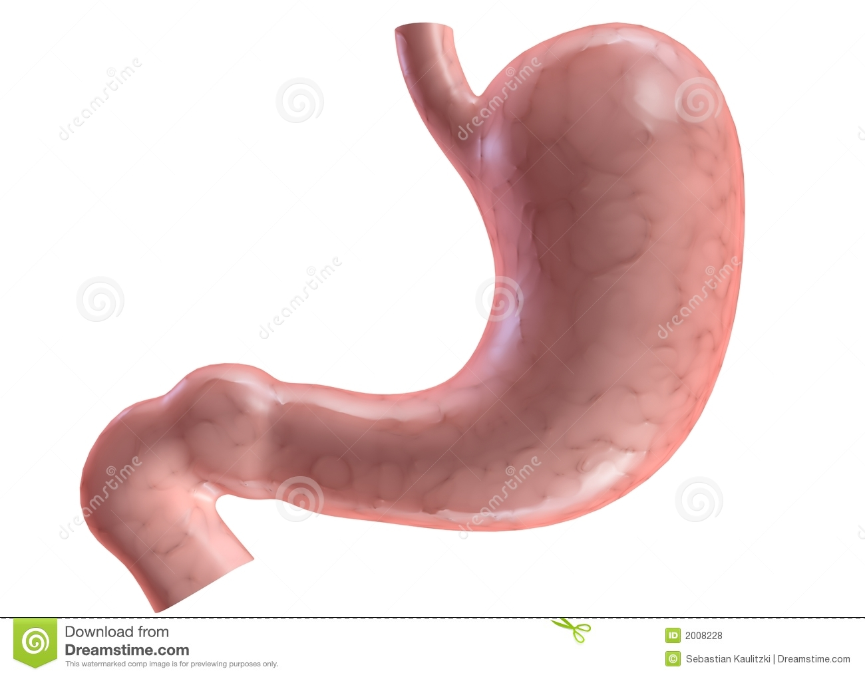
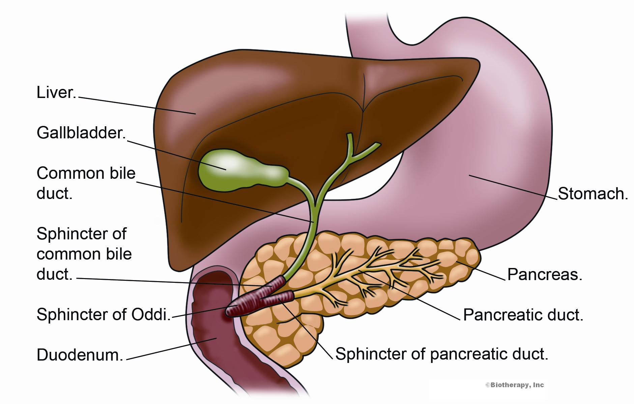
Parasympathetic nervous system
Effect on thorax and abdomen :
vagus nerve : ( 10th cranial nerve )
Action : on abdomen
  GIT :
    motor to the wall
    inhibitory to sphincters
  gall bladder : ( evacuation )
    motor to the wall
    inhibitory to sphincter of oddi

Slide 9
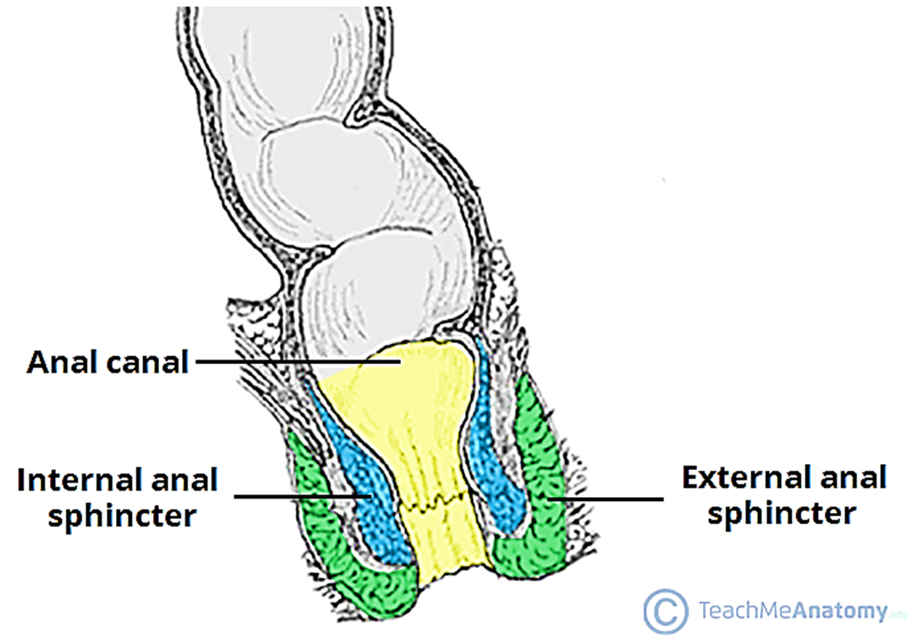
Parasympathetic nervous system
Effect on pelvis :
  Origin: S2, 3, 4
  Course: pelvic nerve
  Relay: terminal ganglia
  On the rectum : (defecation )
    contraction of wall
    inhibition of internal anal sphincter

Slide 10
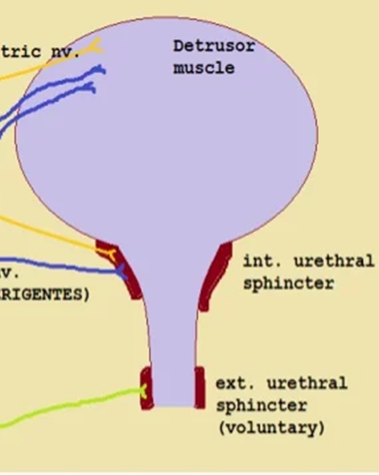
Parasympathetic nervous system
Effect on pelvis :
on the urinary bladder : ( micturition )
  contraction of wall
  inhibition of internal urethral sphincter
  On male genitalia :
    erection

Slide 11


